Slide 1

“Online Voting System Using Blockchain”
TERNA ENGINEERING COLLEGE
DEPARTMENT OF COPUTER ENGINEERING
BE/SEM-VII
C-23 Atharva Birje
C-28 Harsh Minde
C-44 Jyotiraditya Patil
C-63 Ameya Mane
Under the guidance of
Prof. Dnyaneshwar Thombre
Academic Year
2024-25

Slide 2
CONTENT
Introduction
Abstract
Literature review
Problem Statement
Objective of Project
Scope of Project
Proposed System/ Architecture Diagram
H/W and S/W requirements
Expected Outcome
Refrences

Slide 3
INTRODUCTION
In recent years, blockchain technology has become a key solution for modernizing voting systems. As a decentralized digital ledger, blockchain ensures transparency, immutability, and security, making it ideal for online voting. By accurately recording votes in a tamper-proof system, it enhances voter privacy, increases trust, and prevents fraud, offering a more secure and reliable alternative to traditional voting methods.

Slide 4
ABSTRACT
This system ensures transparency, security, and integrity in the voting process by using a decentralized, tamper-proof public ledger. It guarantees voter anonymity through advanced cryptographic techniques while offering a convenient and accessible platform to increase voter participation. The system's immutability ensures that once votes are recorded, they cannot be altered.

Slide 5
LITERATURE SURVEY
Sr. No. | Project Title | Author | Summary
1. | Blockchain Enabled Online-Voting System | Akhil Shah, Nishita Sodhia, Shruti Saha, Soumi Banerjee, Madhuri Chavan​ 2020 | This research proposes a secure, transparent online voting system using blockchain technology. It employs an Android app with AES-128 encryption, SHA-256 hashing, fingerprint authentication, and OTP verification. Votes are recorded on the Ethereum blockchain, ensuring tamper-proof and efficient election processes, with scalability for national use.
2. | A Scalable Implementation of Anonymous Voting over Ethereum Blockchain | Jae-Geun Song, Sung-Jun Moon, Ju-Wook Jang 2021 | This research addresses the scalability challenges in anonymous voting systems on the Ethereum blockchain. The proposed scheme optimizes gas consumption, reduces time complexity, and resolves tallying failures caused by the absence of votes from registered voters. The system uses algorithmic improvements to enhance performance, ensuring a scalable and efficient voting process. While the solution significantly lowers transaction costs and improves scalability, it does not delve deeply into privacy issues and assumes reliable user interfaces for private key management.

Slide 6
Sr. No. | Project Title | Author | Summary
3. | Implementation of Decentralized Blockchain E-voting | Saad Moin Khan, Aansa Arshad, Gazala Mushtaq, Aqeel Khalique, Tarek Husein 2018 | This research proposes a decentralized electronic voting system using blockchain technology to enhance security, transparency, and reliability. The system leverages Ethereum blockchain and smart contracts to ensure immutable and verifiable votes. It addresses common e-voting issues like hacking and vote tampering. The solution utilizes tools such as Ganache, Truffle, NPM, and Metamask for secure vote casting and management. Though it significantly reduces security risks, the paper notes the need for addressing scalability concerns in large-scale elections.
4. | Decentralized Voting Platform Based on Ethereum Blockchain | David Khoury, Elie F. Kfoury, Ali Kassem, Hamza Harb 2020 | This research introduces a decentralized voting platform utilizing the Ethereum blockchain to ensure secure, transparent, and tamper-proof elections. The system employs smart contracts to handle voting processes, enhancing the security and transparency of the voting system. The decentralized nature of the platform eliminates the need for a trusted third party, providing a reliable and robust voting mechanism. Although the paper primarily focuses on security and transparency, it highlights the need for addressing scalability concerns for broader adoption.

Slide 7
PROBLEM STATEMENT
PROBLEM STATEMENT :
Traditional voting methods suffer from vulnerabilities, inefficiencies, and security concerns. Manual processes and outdated electronic systems are prone to errors, susceptible to tampering, and lack transparency. The need for a modern, secure, and transparent voting system is evident, especially in light of increasing demands for trustworthy electoral processes. Governments and organizations are seeking a solution that addresses these challenges effectively. Blockchain technology emerges as a promising alternative to revolutionize online voting, providing transparency, security, and enhanced trust in the electoral process.

Slide 8
OBJECTIVE
OBJECTIVE :
1.Enhance Security
2. Increase Transparency
3. Ensure Voter Privacy
4. Improve Accessibility
5. Guarantee Immutability
6. Reduce Costs
7. Enhance Trust
8. Facilitate Real-Time Results

Slide 9
SCOPE OF THE PROJECT
The project involves developing a secure, transparent, and user-friendly blockchain-based online voting system. This system will replace traditional voting methods with a modern, decentralized approach that enhances the integrity and trustworthiness of the electoral process.
The scope of the project includes:
Development of Mobile Application
Integration with Blockchain Technology
Secondary Database Integration
Security and Performance
Scalability and Performance

Slide 10

TIMELINE CHART

Slide 11


Slide 12
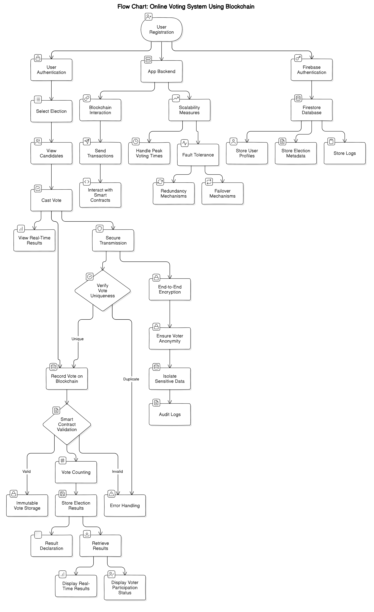
PROPOSED SYSTEM

Slide 13
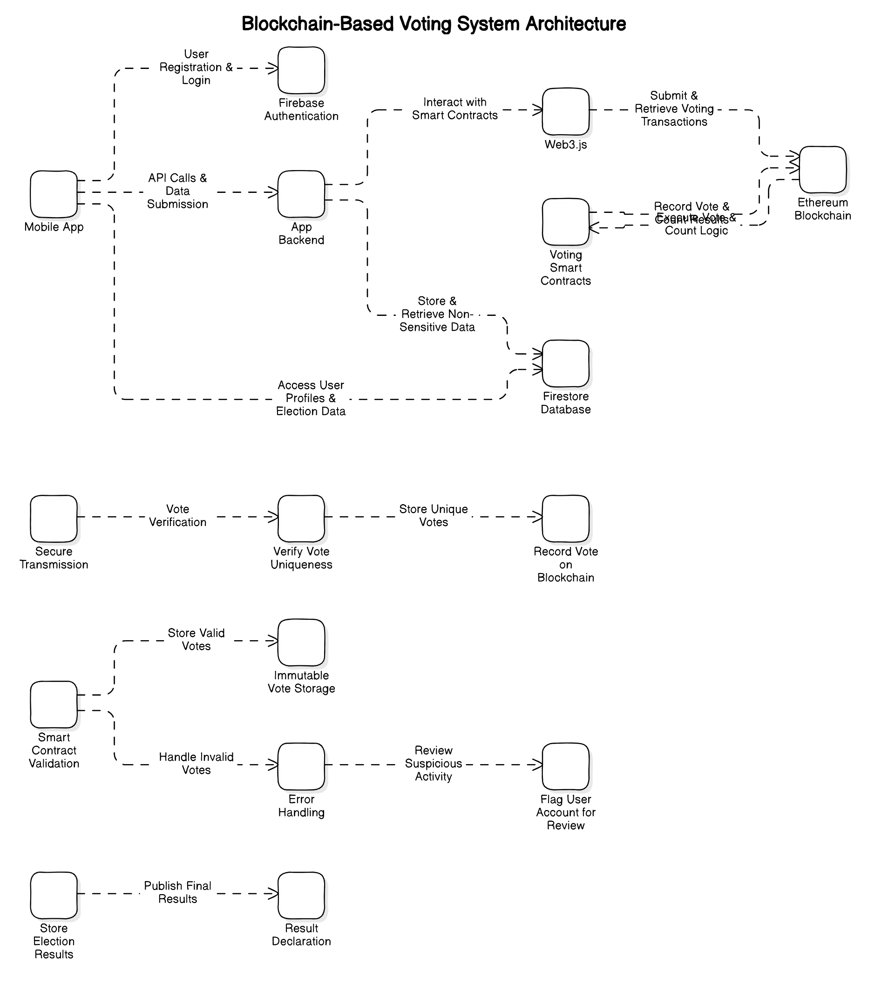
Architecture Diagram:

Slide 14
Sequence Diagram :-

Slide 15
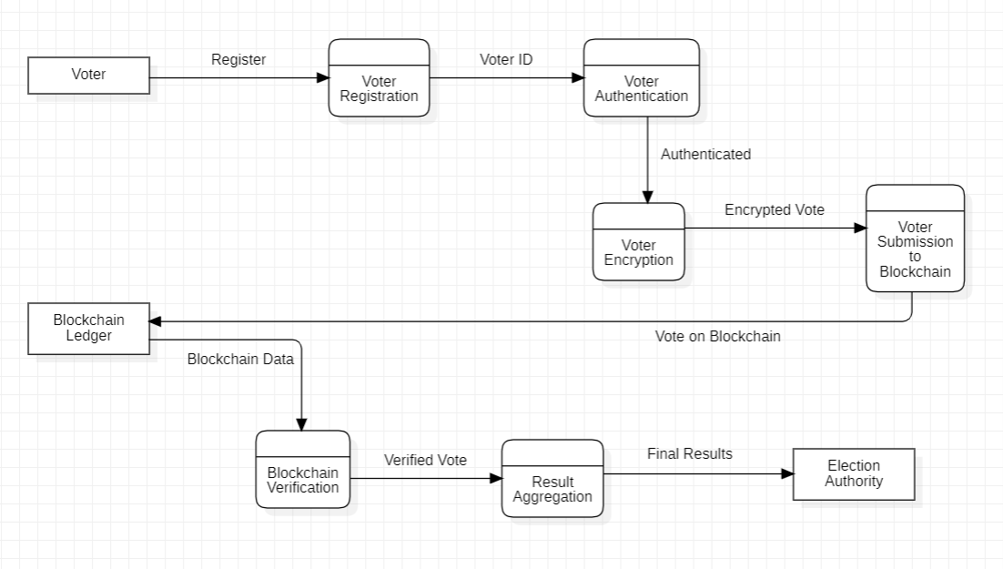
Data Flow Diagram (DFD) :-

Slide 16
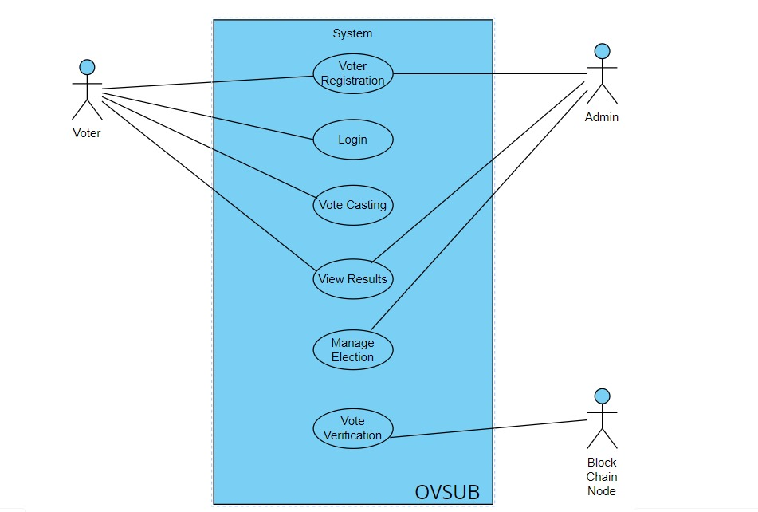
Use Case Diagram (UCD) :-

Slide 17
PROPOSED SYSTEM
Users register and log in using Firebase Authentication, secured by biometric and two-factor authentication. After successful login, they cast votes via a secure interface, with each vote recorded on the Ethereum blockchain using Solidity smart contracts to ensure uniqueness and prevent duplication. Non-sensitive data is stored in Firebase Firestore, while sensitive vote data is securely stored on the blockchain for transparency. Real-time election results are fetched from the blockchain and displayed on a user-friendly interface developed in Android Studio/Flutter. The system ensures end-to-end encryption, voter anonymity, and is designed to handle large user loads during peak voting times.

Slide 18
HARDWARE USED
Mobile Devices:
Smartphones (iOS and Android)
Tablets (iOS and Android)
Servers:
Blockchain nodes servers
Backend servers
Cryptographic Hardware:
Hardware Security Modules (HSM)
Development and Testing Hardware:
Laptops/Desktops for developers
Test devices (various models of smartphones and tablets)
5. Security Hardware:
Biometric authentication devices (optional, for enhanced security)
Two-factor authentication (2FA) devices

Slide 19
SOFTWARE USED
1.Blockchain Platforms:
- Ethereum
- Hyperledger Fabric
2. Smart Contract Development:
- Solidity
3. Cryptographic Libraries:
- OpenSSL
- libsecp256k1
4. Mobile App Development Frameworks:
- Android
- Flutter
5. Backend Development:
- Node.js
6. Database:
- Firebase
- MongoDB
7. Development and Testing Tools:
- Truffle
- Ganache
- Remix IDE
8. Security and Auditing Tools:
- MythX
- Securify
9. API Integration:
- Web3.js
- Ethers.js

Slide 20
EXPECTED OUTCOMES
Secure Voting: A system where voters can securely cast their votes via a mobile application.
Immutable Vote Records: All votes are recorded on the blockchain, ensuring they cannot be altered or tampered with.
Transparent Election Process: The system will ensure transparency by providing a public ledger accessible to all participants.
Voter Privacy: The system will protect voter identity and ensure anonymity.
Real-Time Results: Election results will be available in real-time, directly calculated from the blockchain.
Scalability: The system will be capable of handling a large number of users, suitable for various scales of election.
Auditability: Election officials will have access to audit logs, ensuring the integrity of the election process.

Slide 21
REFERENCE
Research Papers and Articles:
Akhil Shah, Nishita Sodhia, Shruti Saha, Soumi Banerjee, Madhuri Chavan (2020). "Blockchain Enabled Online-Voting System," ITM Web of Conferences, 32, 03018.
Jae-Geun Song, Sung-Jun Moon, Ju-Wook Jang (2021). "A Scalable Implementation of Anonymous Voting over Ethereum Blockchain," IEEE Access, 9, 37930-37942.
Saad Moin Khan, Aansa Arshad, Gazala Mushtaq, Aqeel Khalique, Tarek Husein (2018). "Implementation of Decentralized Blockchain E-voting," International Journal of Computer Applications, 182(20), 1-5.
David Khoury, Elie F. Kfoury, Ali Kassem, Hamza Harb (2020). "Decentralized Voting Platform Based on Ethereum Blockchain," 2020 International Conference on Decentralized Applications and Infrastructures (DAPPS), 65-70.

